Slide 1
TOTTENHAM HOTSPUR FOUNDATION

Slide 2
FOUNDATION OVERVIEW
ESTABLISHED IN 2006
ETHOS ‘CREATE OPPORTUNITIES THAT CHANGE LIVES’
5 KEY AREAS OF WORK
EMPLOYMENT AND SKILLS
COMMUNITY DEVELOPMENT
HEALTH AND WELLBEING
EDUCATION
EQUALITIES AND INCLUSION
129 STAFF
75 VOLUNTEERS

Slide 3
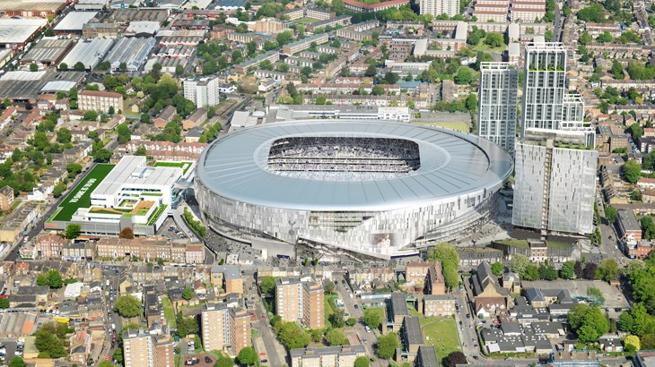
WHITE HART LANE STADIUM REGENERATION

Slide 4
THE JOURNEY TOWARDS EVIDENCE BASED PRACTICE
VIEWS AMBASSADORS
KEY LEADS ASSIGNED DEPARTMENTS & PROJECTS
FORTNIGHTLY UPDATES TO REVIEW PROGRESS & MONITOR CHANGE IN DIRECTION
THE AIM
MASS DATA COLLECTION THROUGH OUR MONITORING SYSTEM ‘VIEWS’
KEY INFORMATION FOR COACHES TO COLLECT: NAME, GENDER, DOB, POST CODE
SHOWCASING OUR STORY
REAL LIFE EXAMPLES
MEDIA PROFILING
CASE STUDIES (JOJO CLARKE)

Slide 5
THE JOURNEY TOWARDS EVIDENCE BASED PRACTICE
PROGRESSION OF DATA COLLECTION
VIEWS AMBASSADORS ROLE CHANGES
GREATER EMPHASIS PLACED ON DETAILED REPORTING
CHANGE IN REPORTING PROCEDURES
DEPARTMENT MANAGER
PROJECT LEADS
VIEWS AMBASSADORS
IMPACT REPORT
PRODUCED, REVIEWED & DELAYED
TESTED THE SYSTEM AND WITH THE CHANGES MADE THE REPORT DOUBLED OUR UNIQUE USERS AND OVERALL ROI

Slide 6
THE JOURNEY TOWARDS EVIDENCE BASED PRACTICE
HOW DO WE GET TO THE NEXT LEVEL?

Slide 7
THE JOURNEY TOWARDS EVIDENCE BASED PRACTICE
DATA CO-ORDINATOR
DIRECT CONTACT WITH PROJECT MANAGERS AND DEPARTMENT LEADS
MORE CONSISTENT FOLLOW UP
OUTCOMES LINKED TO MORE ACCURATE REPORTING
OUTLINING PROJECT SPECIFIC TARGETS
PROVIDING COMPELLING EVIDENCE OF THE IMPACT AND VALUE OF THE PROGRAMMES
BENEFITS & OUTCOMES
GREATER ATTENTION TO DETAIL TO COLLECT DATA
ALL DEPARTMENTS ARE STREAMLINED TO GATHER DATA
HAVING ONE FOCAL POINT TO ELIMINATE ISSUES/PROVIDE SUPPORT

Slide 8
MAIN AUDIENCE
BOARD OF DIRECTORS
GOVERNMENTS (IMPACT)
FUNDERS (KEY FINANCIAL BACKERS, PAYMENT BY RESULT CONTRACTS)
INTERNAL STAFF (FUTURE BID WRITING, SUPPORTING DOCUMENTS)
PARTICIPANTS (FOR FUTURE INFORMATION)
* STADIUM REGENERATION

Slide 9
WHAT HAS THE FOUNDATION LEARNT & WHAT DO WE NOW DO DIFFERENTLY
IMPACT OF VIEWS TO TELL A STORY
GREATER RESPONSIBILITY IS PLACED ONTO DEPARTMENT MANAGERS AND PROJECT LEADS
HOW CAN WE REGULARLY SHOWCASE WHAT WE DO?
ACCURATELY COMMUNICATE TO KEY STAKEHOLDERS
MANAGING EMPLOYEES
PERFORMANCE MANAGEMENT
STAFF APPRAISALS
OPERATING SYSTEMS (RECRUITMENT, RETENTION, ANNUAL LEAVE, SICKNESS)
REPORTING PROCESSES
ONE KEY POINT OF CONTACT
REPORTING TIMELINES
MANAGING RESULTS/FEEDBACK
MAINTAIN TARGETS & OUTCOMES

Slide 10
CAN YOU GIVE US AN IMAGE/OVERVIEW OF THE DIFFERENT LAYERS IN YOUR ORGANISATIONAL STRUCTURE?

Slide 11
‘LAYER CAKE’
1 AGENCY PROJECT
2 SESSION GROUP
3 SESSION
4 PARTICIPANT

Slide 12
CAN YOU CHANGE YOUR METHODS TO MIRROR THIS WAY OF STRUCTURING YOUR DATA?

Slide 13
OUTCOME FRAMEWORK

Slide 14
THANK YOU FOR LISTENING!

